Slide 1
Predicting outcomes for Adjudicative appeals through Machine Learning
Michaela Webster
MSISPM Thesis
June 20, 2019

Slide 2
Previous work
Thesis by Sarah Miller (MSISPM 2017)
Database for Adjudicative Appeals cases
Includes data points for all guidelines
Primary focus on falsification
Notes:
Created a database for cases – includes information on decisions and reasons for initial denial
Hand coded cases from documents in api
Preliminary stats done on information (20,000+ records)
Focus on falsification (about ¼ of cases in data set) – only up to 2016 (still need to code 2017&2018)

Slide 3
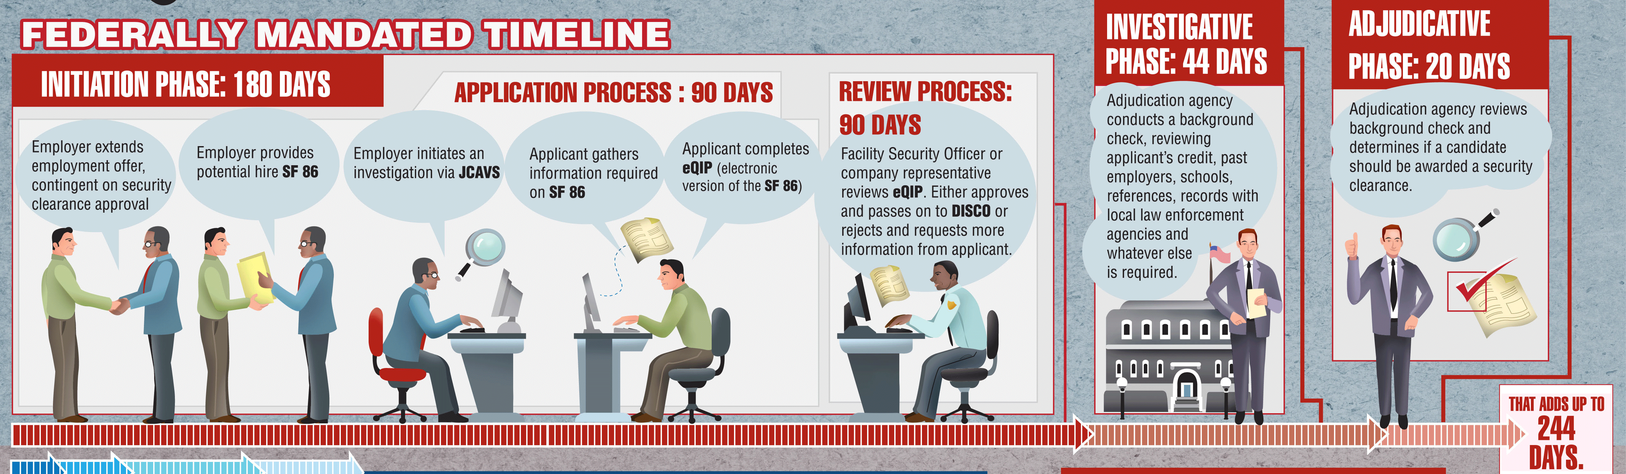
Security Clearance process
https://4d0q7u11k31p1qnkosal8q2e-wpengine.netdna-ssl.com/wp-content/uploads/2013/04/security-clearance-process-infographic.gif
Notes:
Hired -> job asks for investigation -> fill out SF86 -> reviewed -> decision made
There are 13 adjudicative guidelines:
A: Allegiance to the U.S.
B: Foreign Influence
C: Foreign Preference
D: Sexual Behavior
E: Personal Conduct
F: Financial Considerations
G: Alcohol Consumption
H: Drug Involvement
I: Psychological Conditions
J: Criminal Conduct
K: Handling Protected Information
L: Outside Activities
M: Use of Information Technology

Slide 4
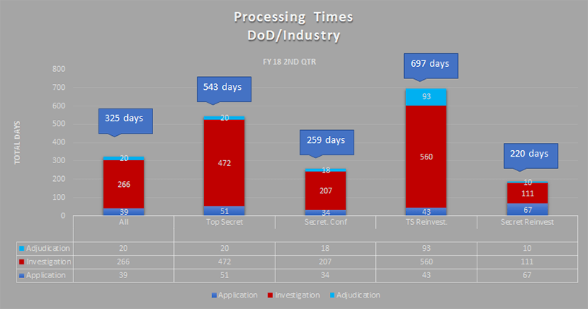
https://news.clearancejobs.com/2018/07/18/security-clearance-processing-times-continue-to-creep-upward/
Notes:
Averages > 1 year
Due to robustness of application information/investigation process
Significant backlog of applications and appeals (500,000) - https://news.clearancejobs.com/2019/04/16/latest-update-on-the-security-clearance-backlog-and-transfer-to-dod/

Slide 5
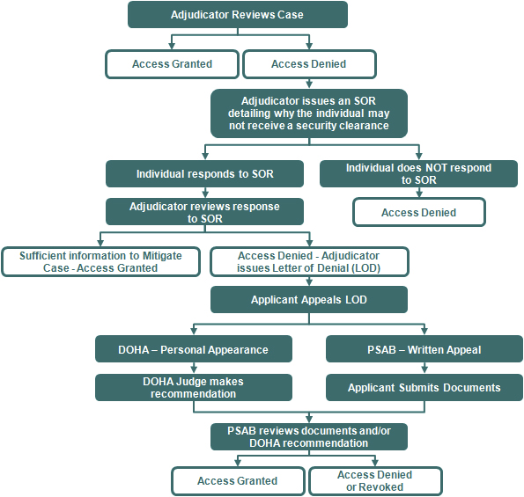
Adjudicative appeals
http://www.dami.army.pentagon.mil/site/PSAB/AdjProc.aspx
Notes:
Process:
Denied -> send notes to individual -> send back responses -> APPEAL -> reinvestigate -> decision

Slide 6
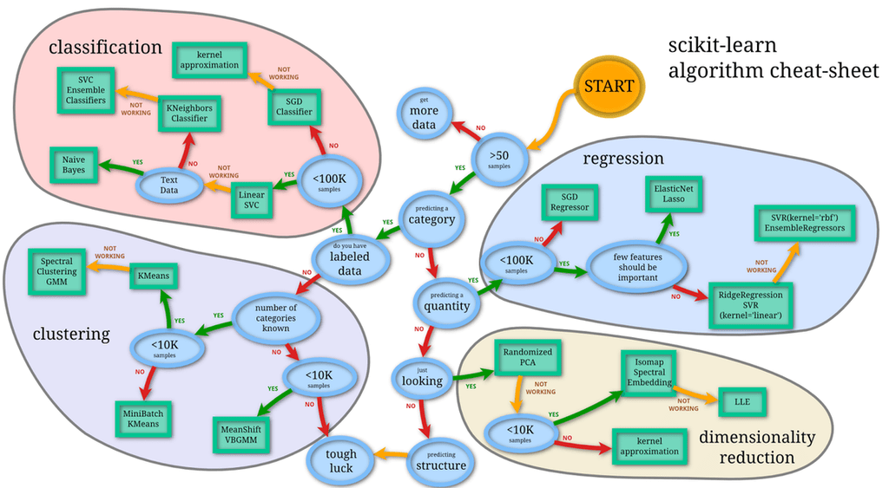
Machine learning
http://blog.kaggle.com/2015/04/15/scikit-learn-video-2-setting-up-python-for-machine-learning/
Notes:
Pros:
Helpful for making complex decisions in little time
Lots of information and apis online with support
Powerful and theory/stats driven
Cons:
Depends on dataset
Depends on input
Could be slow/costly to implement

Slide 7
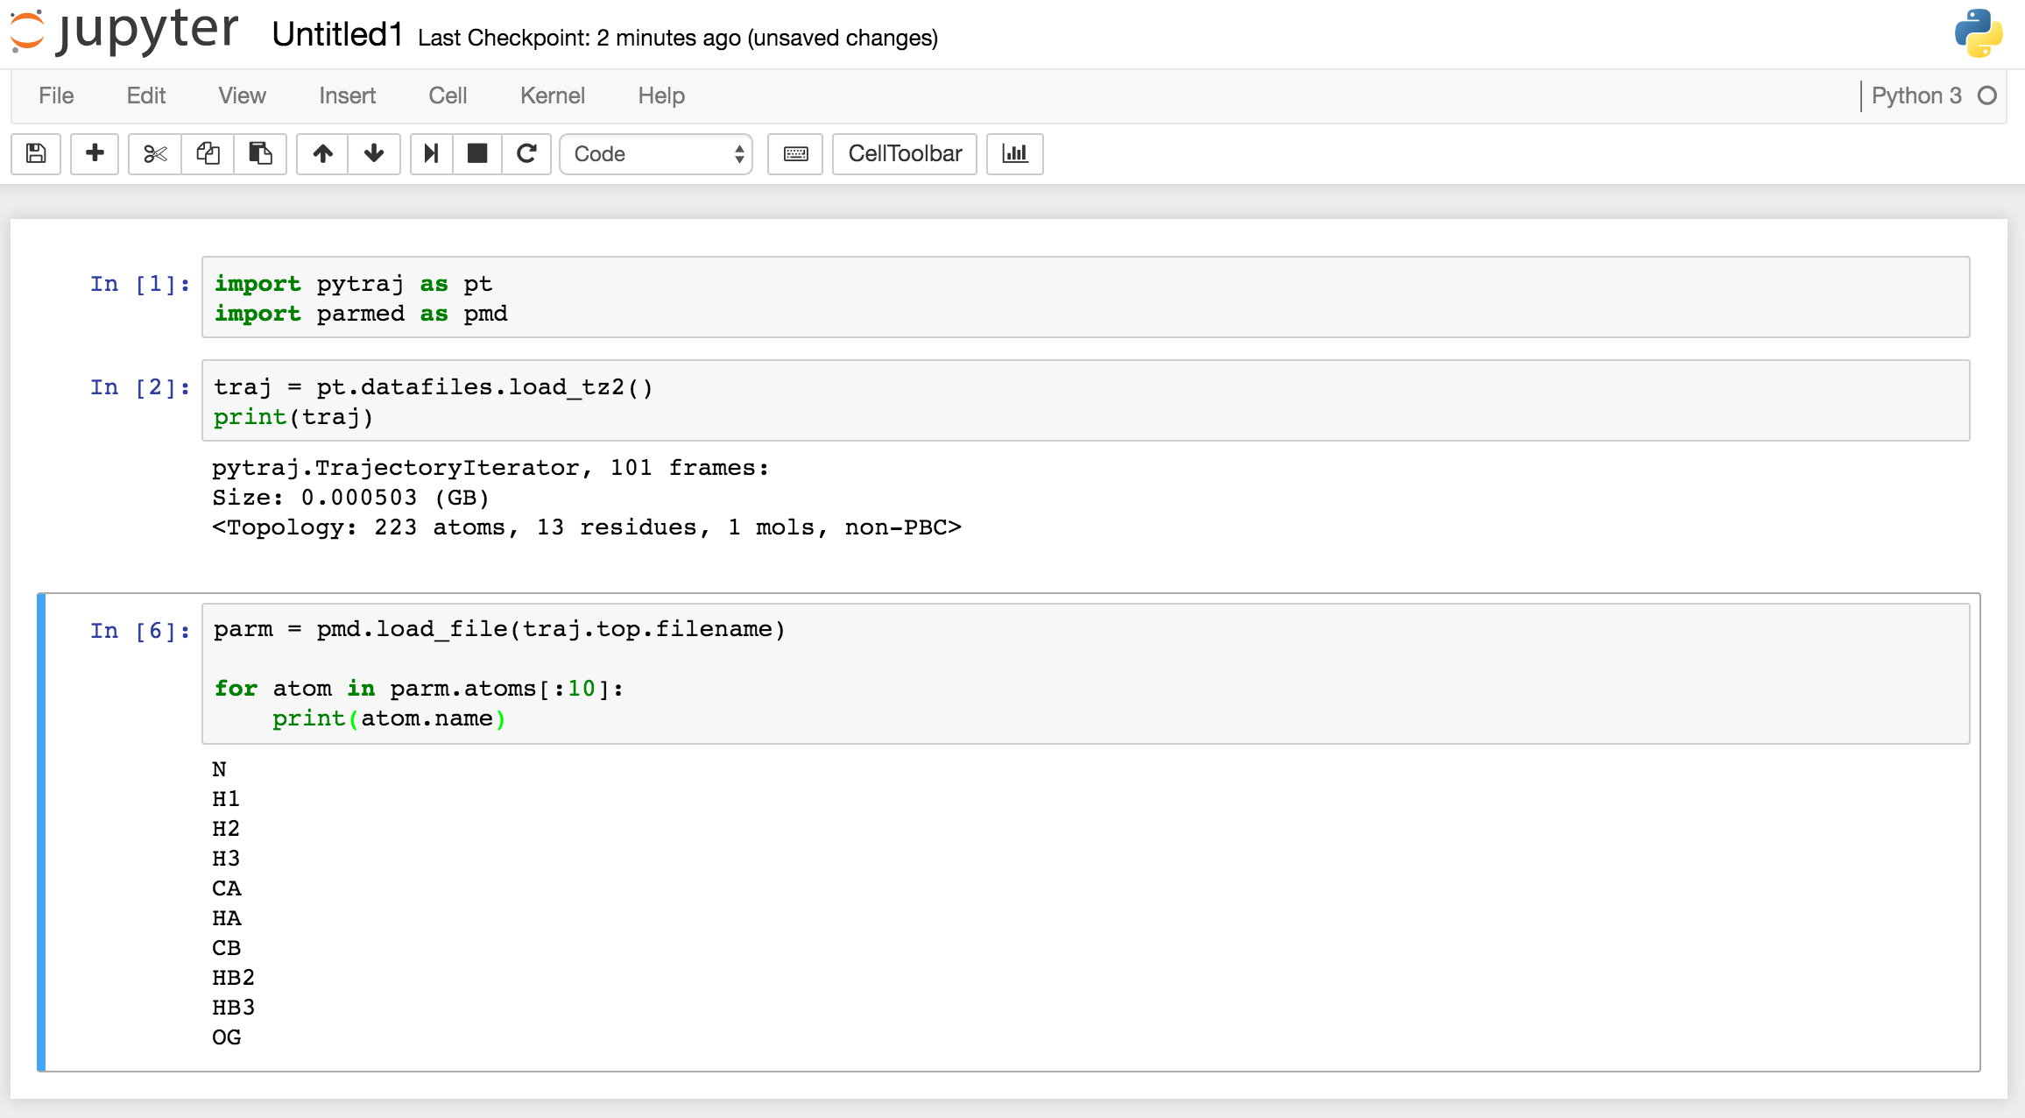
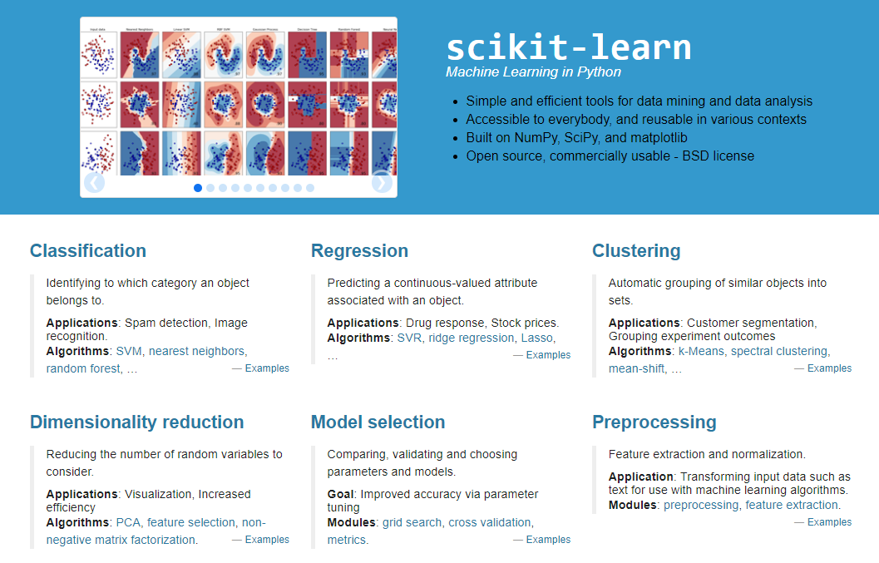
Scikit-Learn
http://ambermd.org/tutorials/analysis/tutorial_notebooks/remote_notebook/index.html
Jupyter Notebooks
https://scikit-learn.org/stable/
Notes:
Tools we will use:
1. Jupyter notebooks:
* Simple design
* User friendly
* Easy to debug code
* Graphs
Sci-Kit Learn:
* Machine learning api
* Lots of documentation
* Lots of functionality

Slide 8
Machine Learning Process
Notes:
All notebooks follow the same flow
Prime the data for input (columns in db – true/false vals)
Feed into sci-kit learn model for log reg to build fit
Send in test data to predict the outcome based on training data
Spit out predictions
Calculate accuracy based on model
F1 score – precision and recall
Precision = # correct positive results/# of all positive results returned by classifier
Recall = # # correct positive results/# of all relevant samples (samples that should have been identified as positive)

Slide 9
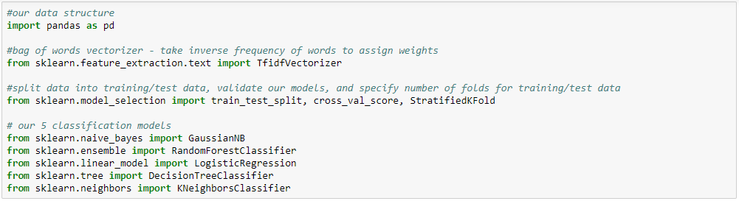
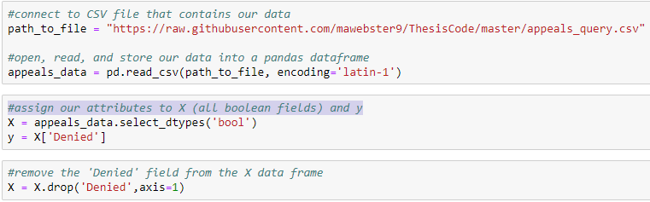
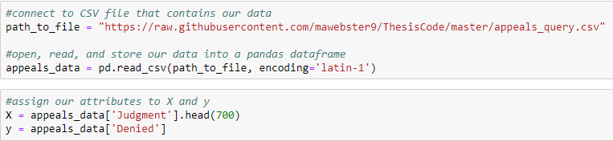
Importing Packages
Importing Boolean Fields
Importing Text Fields
Notes:
1. We imported our necessary packages for all process.
2. We imported the dataset – housed in a csv file
3. We specified which fields would be in X (features) and what field would be in y (labels).
For Boolean values we specified that all True/False fields (minus Denied) would be in our X and the Denied column would be our y.
For Text values we specified that the Judgment field would be our X and the Denied field would be our y. We also reduced the amount of records for the X and y because text data is bulky – without this we would get a memory error. We picked 700 as the number of records.

Slide 10
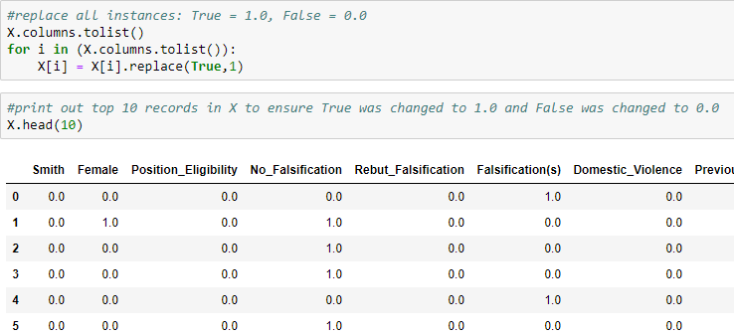
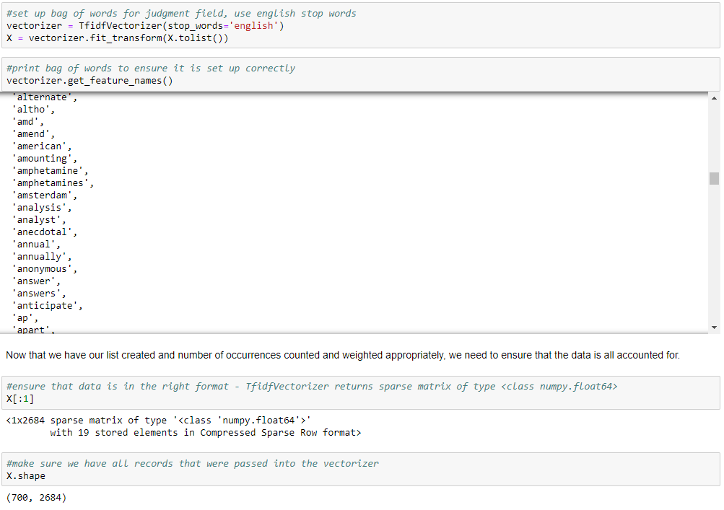
Transforming Boolean Data
Transforming Text Data
Notes:
BOOLEAN:
For Boolean values, we need to set up our X values in a way that a machine learning algorithm can understand it. In order to do this we need to change our true/false values into a numeric format. To do this, we need to change all true values to 1.0 and all false values to 0.0. We did this for both the X and y values.
TEXT:
For text data, we need to break up the words in a way that a machine can understand the characteristics of speech. One of the ways we can do this is by using a bag of words. A bag of words essentially takes a large amount of text data and separates the values into separate words and counts the number of occurrences of each word.
For this example, we will be using a vectorizer to split the words and calculate the number of occurrences for each word. The vectorizer we will use in this example, TfidfVectorizer, works by counting the inverse frequency of the words found in the judgment field to assign a weight for each word. This ensures that common words, also known as "stop words", found in the english language, like "the", "a", "an", etc., are weighted less than words that are unique for this dataset, such as "foreign", "alcohol", "drugs", etc.
Four our y values, we need to change all true values to 1.0 and all false values to 0.0.

Slide 11
Machine Learning Step-By-Step

Slide 12
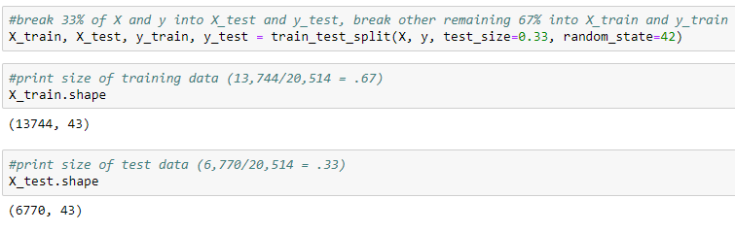
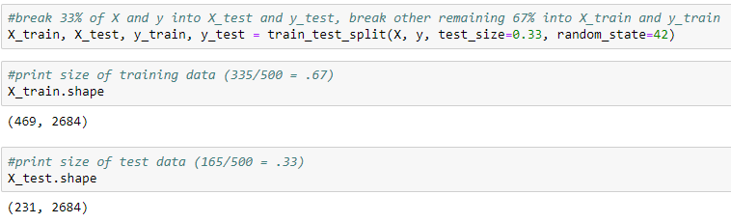
Run train_test_split() on X & y
Boolean
Values
Text
Values
Notes:
The train_test_split() function works by taking the X & y data and splitting it up into groups, one for training and one for testing. We specified that we want there to be 3 splits (test_size) – the training always gets the majority of the data so our training data (X_train, y_train) will have 67% of the data, and our test data will have 33% of the data (X_test, y_test). We have also specified that we want to ensure that each time we run the algorithm it will give us the same answer (random_state).

Slide 13
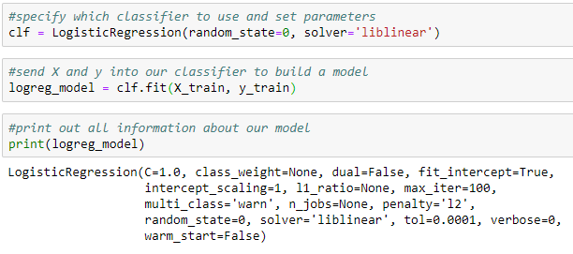
Run fit() on X_train and y_train
Notes:
The next step in our machine learning model is taking our training data and feeding it into an algorithm to build a model. This is essentially the step that teaches an algorithm that for each record X = y. To do this, there are a number of classification models. For this example we will focus on the LogisticRegression classifier.

Slide 14
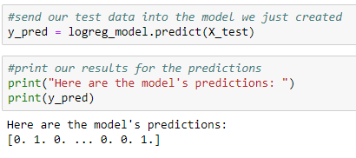
Run predict() on X_test
Notes:
The next step in our process is to take the model we just made using the training data and feed the test data into it. This will output an array of values that the algorithm has determined to be the denied status.

Slide 15
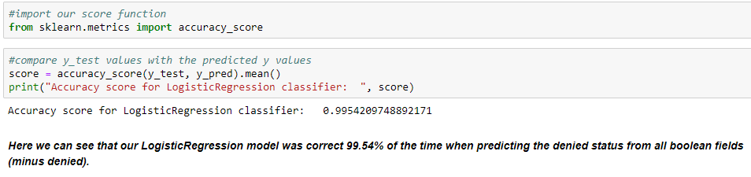
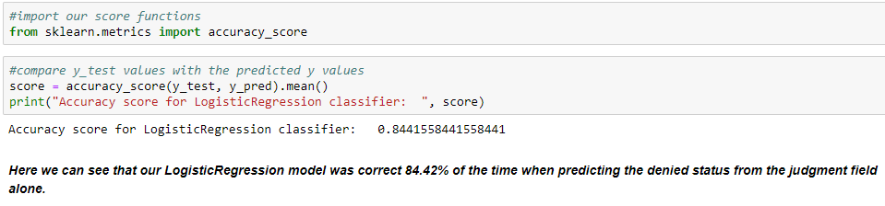
Verify the Accuracy of the Model
Boolean
Values
Text
Values

Slide 16
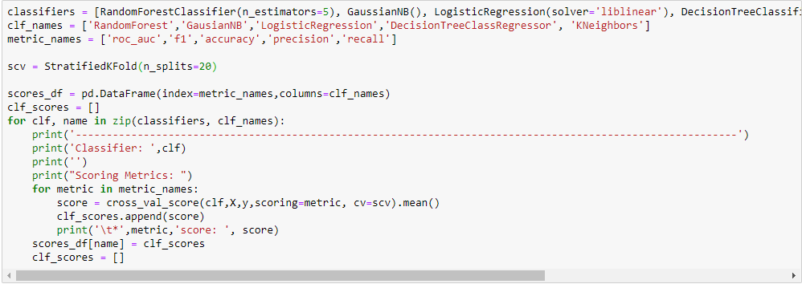
Test for the Best Algorithm to Use
Notes:
Now that we understand how machine learning is done, we can determine which model is the best choice for our data. In this example we will use 5 different classifiers and evaluate each against 5 accuracy metrics.
Note:
1. For picking a fold size, it is recommended to choose n=5, 10, or 20 (http://vinhkhuc.github.io/2015/03/01/how-many-folds-for-cross-validation.html). For this problem, we have chosen K = 20 and the comparisons can be found at https://github.com/mawebster9/ThesisCode/blob/master/NumFoldsComparison.txt.
2. The cross_val_score() function works by running all of the following functions:
- Shuffle the dataset randomly
- Split the dataset into k (n=20) groups
- For each unique group:
- Take the group as a hold out or test data set
- Take the remaining groups as a training data set
- Fit a model on the training set and evaluate it on the test set
- Retain the evaluation score and discard the model
- Summarize the skill of the model using the sample of model evaluation scores
The cross_val_score() function is essentially an all-in-one function.
3. For the scoring metrics:
- roc_auc: The area under a ROC Curve (plots the fraction of true positives out of the positives (TPR = true positive rate) vs. the fraction of false positives out of the negatives (FPR = false positive rate))
- f_1: The weighted average of Precision and Recall -> (F1 = 2 * ((precision * recall) / (precision + recall)))
- accuracy: A ratio of correctly predicted observation to the total observations -> (Accuracy = (TruePositives+TrueNegatives)/(TruePositives+FalsePositives+FalseNegatives+TrueNegatives))
- precision: The ability of the classifier to not label negative samples as positive -> (Precision = TruePositives/(TruePositives+FalsePositives))
- recall: The ability of the classifier to find all positive samples -> (Recall = TruePositives/(TruePositives+FalseNegatives))

Slide 17
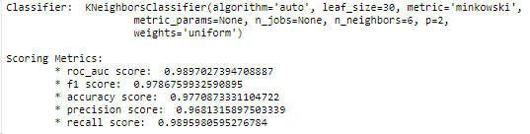
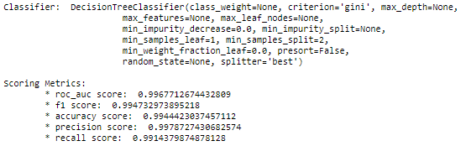
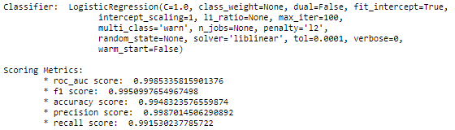
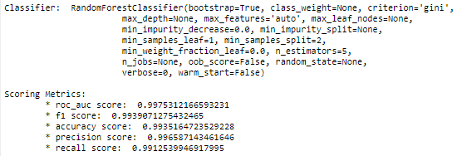
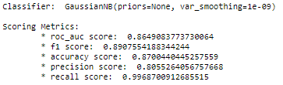
Boolean Algorithm Scoring
#4
#2
#1
#3
#5
Notes:
Accuracy:
LogisticRegression: 99.48%
DecisionTreeClassifier: 99.44%
RandomForestClassifier: 99.35%
KNeighborsClassifier: 97.71%
GaussianNB: 87.00%
For boolean classification, the top performing machine learning algorithm is LogisticRegression followed closely behind by the DecisionTreeClassifier and then the RandomForrestClassifier. Both the works by analyzing a dataset with one or more independent variables that determine an outcome - the outcome is measured with a binary variable (only 2 outcomes possible).
Note: The accuracy_score for LogisticRegression is different in sections 4 and 5 because in section 4 the function was only run once whereas in section 5 it was run 20 times and averaged.

Slide 18
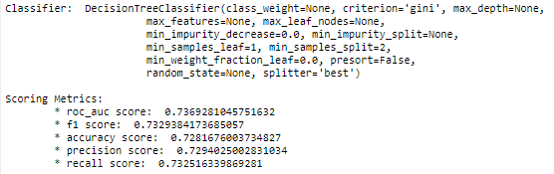
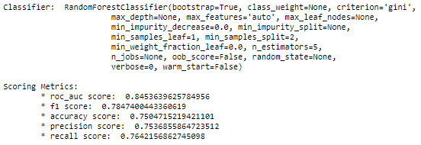
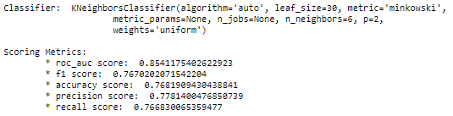
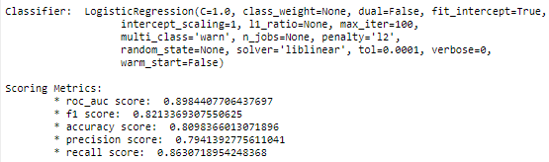
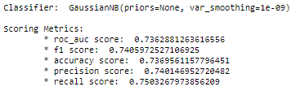
Text Value Scoring
#4
#3
#2
#5
#1
Notes:
Accuracy:
LogisticRegression: 80.98%
KNeighborsClassifier: 76.82%
RandomForestClassifier: 75.05%
DecisionTreeClassifier: 72.82%
GaussianNB: 73.70%
For text classification, the top performing machine learning algorithm is LogisticRegression. This classifier works by analyzing a dataset with one or more independent variables that determine an outcome - the outcome is measured with a binary variable (only 2 outcomes possible).
Note: The accuracy_score for LogisticRegression is different in sections 4 and 5 because in section 4 the function was only run once whereas in section 5 it was run 20 times and averaged.

Slide 19
Use cases and limitations
Accuracy is high – bias?
More data needed
Ethics behind machines vs people
Bulky to maintain/use
Notes:
Accuracy was about 99.48% for Boolean values and about 80.98% for text values -> biased data?
More data = better results
Machines making these decisions – legal issues from applicants about bias
The larger the dataset is the more computing power is needed to run this type of code – adds up

Slide 20
Future work
More data points
Scrape new data
Visualization
Supervised vs Unsupervised
Notes:
Add most recent years of data – the more the better
Investigate if there is a way to scrape this data directly from pdfs – skip the db altogether
More graphs and explanations for model outputs and data
Investigate if Unsupervised methods are better suited for this

Slide 21

https://usatodayhss.com/2018/recruiting-column-10-questions-a-college-coach-might-ask-you

